Slide 1
Introduction to Lego EV3
Summit Denali
Vasu Dalal (vdalal@gmail.com)
https://github.com/vdalal/lego-ev3

Slide 2
Intoductions
Teams: Make your own
2 students per team, 1 EV3 unit per team
1 EV3 brick + 1 laptop or ChromeBook
Mentors
Kritav – 7th grade, Summit Denali
Pui
Vasu

Slide 3
Goal: Demo Day
Goals
Avoid crashes
Stay in the playpen
Move continuously

Slide 4
Session Goals
Be respectful of each other & the class materials
Participate in class, no other distractions
Explore, Discover & Implement
Collaborate: Help each other, Share with the class
Have fun
Have a personal or team goal – What is that 1 (or 2) thing(s) you want to get from the session?

Slide 5
Rough Class Schedule & Plan – (1)
Reference: https://docs.google.com/document/d/1ODXoy8ChpRAfU1ifJo9y75IHdOogI4xekYyTUXGOlkM/edit
Week | Plan | Comments
Week #1 | Introduction - 5 mins EV3 Kit, sensors, code, download etc. Logistics - 5 mins EV3 proficiency, split into groups Norms Discuss - 10 mins Session Goal: Demo Bot MUST work cooperatively (avoid obstacles, not crash) Stay within boundary Discuss/Debate sensor options Build - Driver Base (start) - 45 mins Program - Driver Base Download code Move straight line, move back/forth, & turn Loop(s) Review Goal(s) | 2 students/group, 8 groups, 8 kits Everyone does the same build so we can help each other Challenge: our builds can interact with each other
Week #2 | Discuss: Goal(s) - Session goals Finalize sensor options Program - Driver Base (continued) Move straight line, move back/forth, & turn Loop(s) Add another sensor e.g. ultrasonic sensor Detect obstacle, Stop on obstacle, avoid (turn) on obstacle Add Movement - back/forth & turn Challenge: Display: STOP Sound: Make sound #1 for 3 secs Move back slowly Review Goal(s) | Challenge based on discussion with students

Slide 6
Rough Class Schedule & Plan – (2)
Reference: https://docs.google.com/document/d/1ODXoy8ChpRAfU1ifJo9y75IHdOogI4xekYyTUXGOlkM/edit
Week | Plan | Comments
Week #3 | Discuss Goal(s) - Session goals Add ONE sensor e.g. light sensor Stay within boundary Stop at line boundary, turn back/around Challenge Kill switch: Touch Sensor Display: END Sound: Make sound #2 for 3 secs Move back slowly Review Goal(s) | Challenge based on discussion with students
Week #4 | Discuss Goal(s) - Session goals Program Challenge Simulate a traffic light Stop & Start Catchup Challenge: Stop at line, turn back/around | Challenge based on discussion with students
Week #5 | Discuss Goal(s) - Session goals Program Demo! Catchup Challenge Stop at line, turn back/around Autonomous driving Review Session Goal(s) Inventory the kits

Slide 7
EV3 Brick

Slide 8
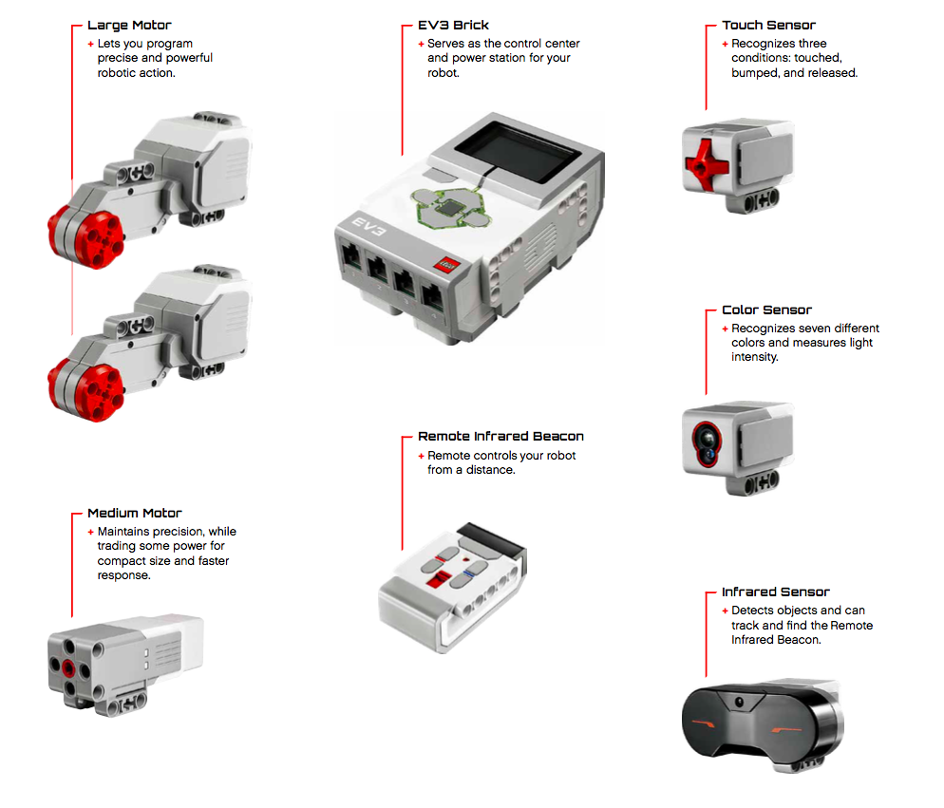
EV3 Elements

Slide 9
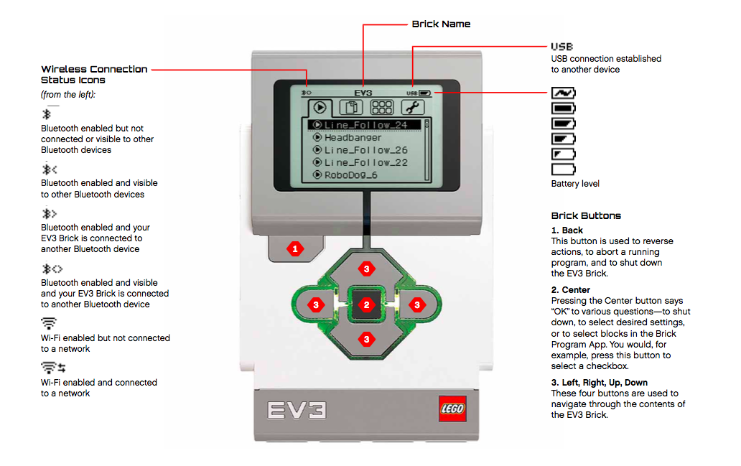
EV3 Buttons

Slide 10
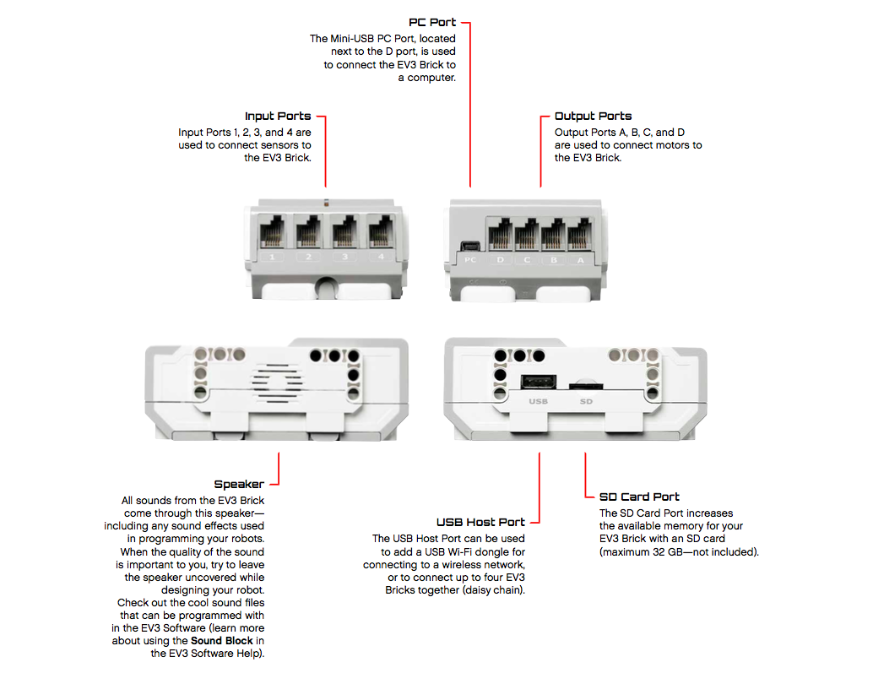
EV3 Input & Output Ports

Slide 11
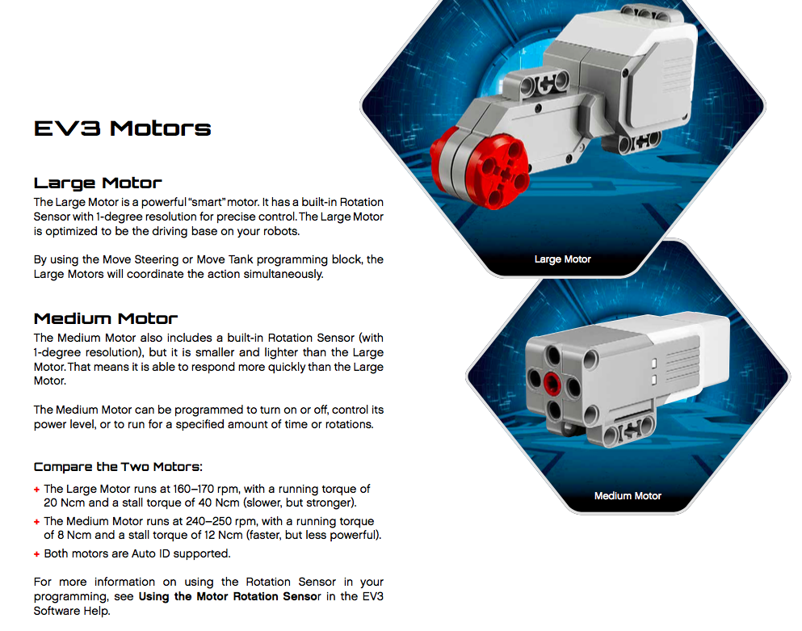
EV3 Motors

Slide 12
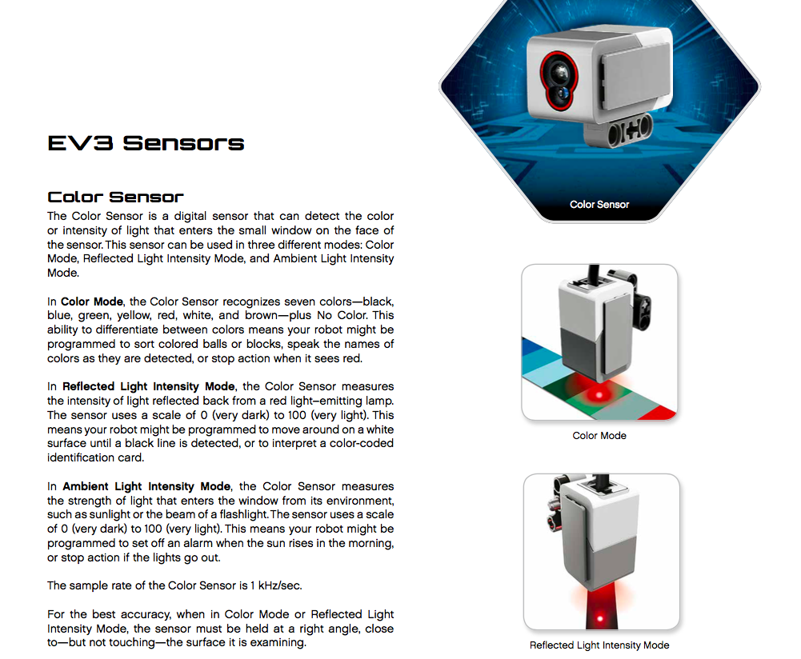
EV3 Color Sensor

Slide 13
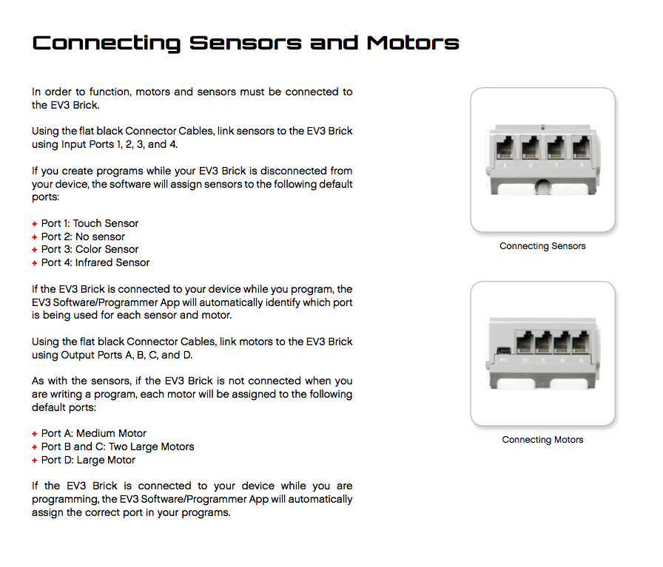
EV3 Sensors & Motors

Slide 14
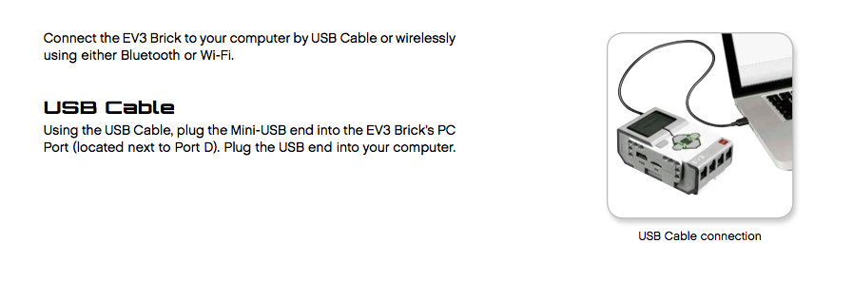
EV3 Connection to the laptop (or PC or Chromebook or Mac)

Slide 15
Build Instructions
Driving Base

Slide 16
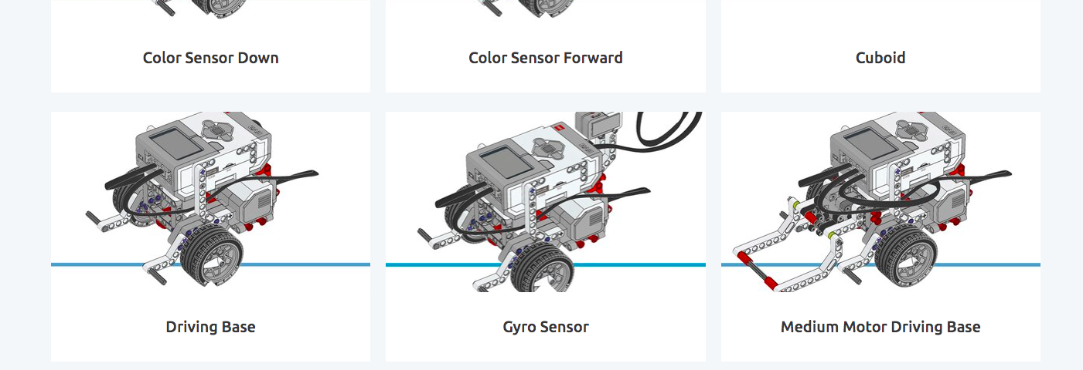
Driving Base
https://education.lego.com/en-us/support/mindstorms-ev3/building-instructions#robot

Slide 17
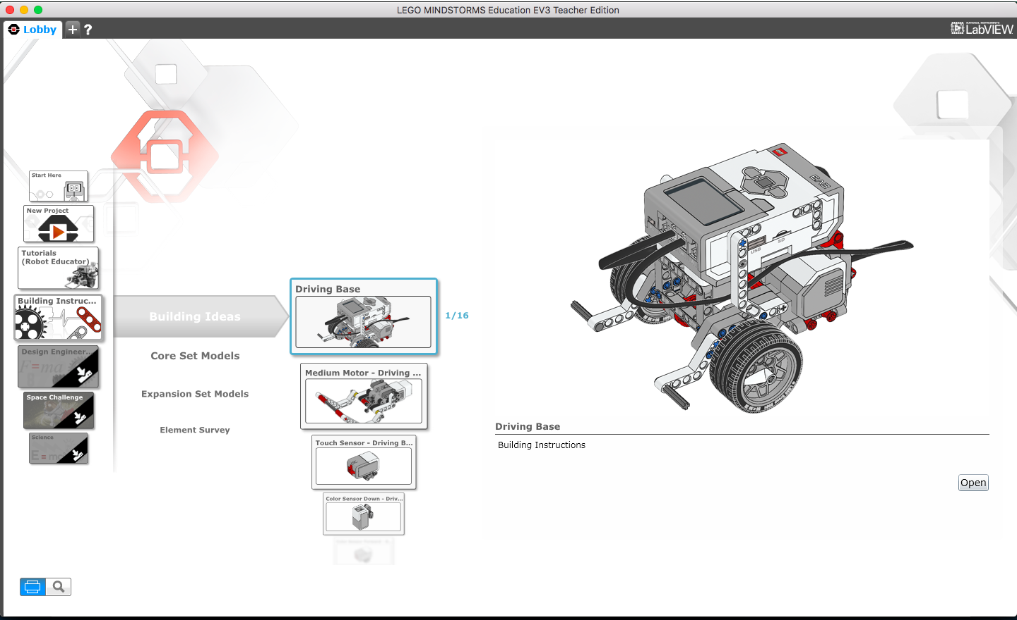
Driving Base

Slide 18
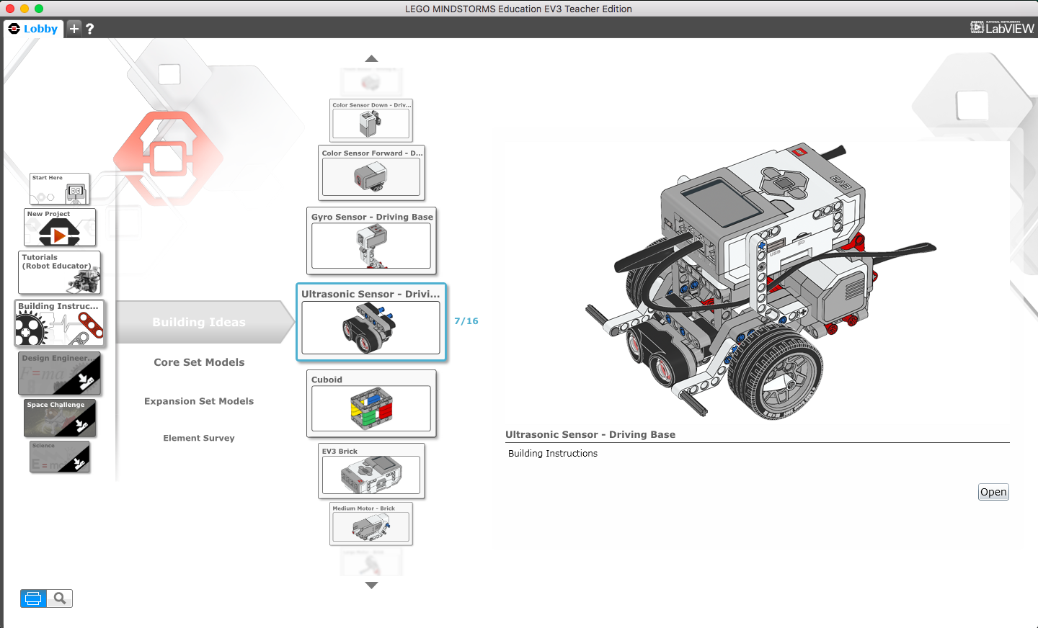
Driving Base – Ultrasonic Sensor

Slide 19
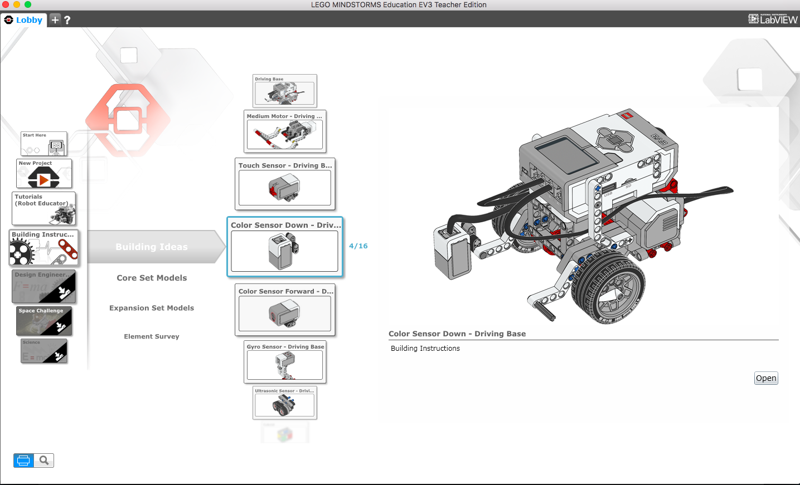
Driving Base – Color Sensor

Slide 20
EV3 Programming App

Slide 21
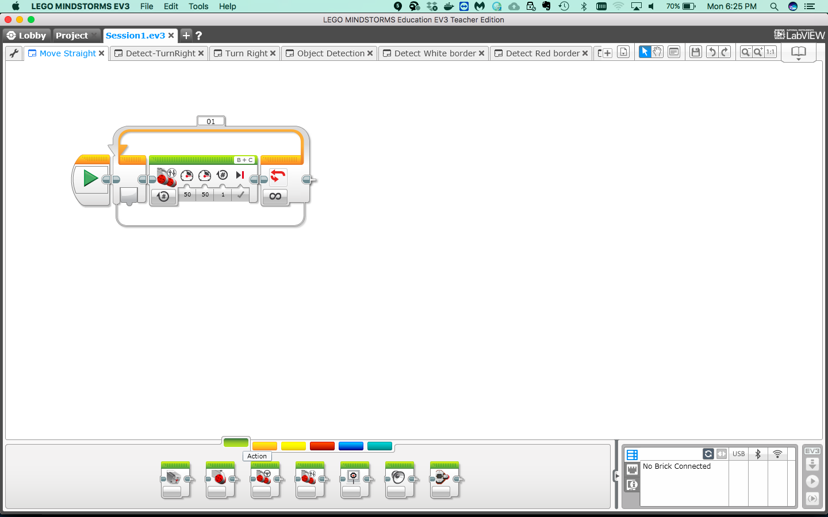
Green Palette = Action
Green palette = Action blocks eg. sm/med motors, move etc.

Slide 22
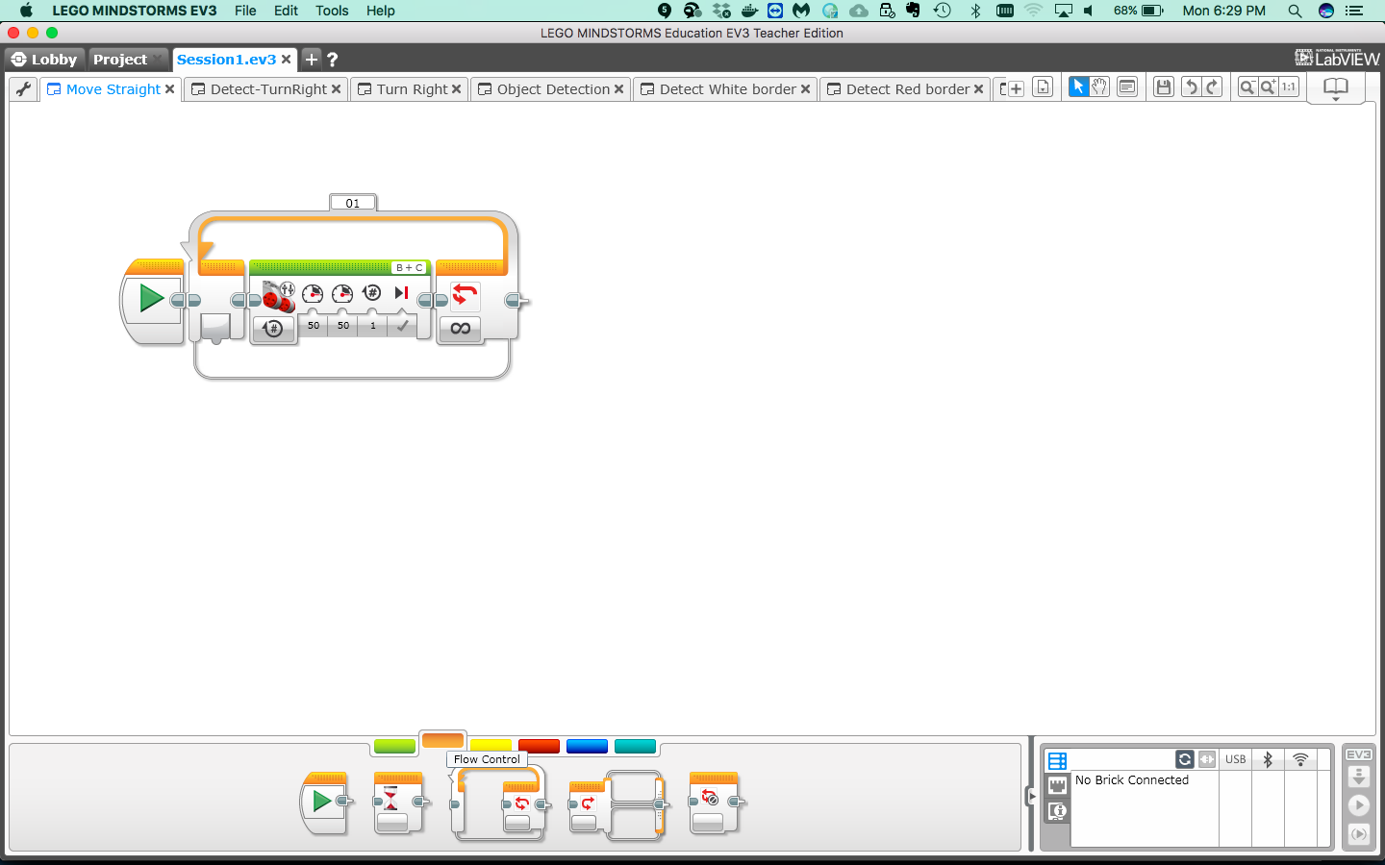
Orange Palette = Logic Control
Orange palette = Logic Flow Control blocks eg. start, loop, switch etc.

Slide 23
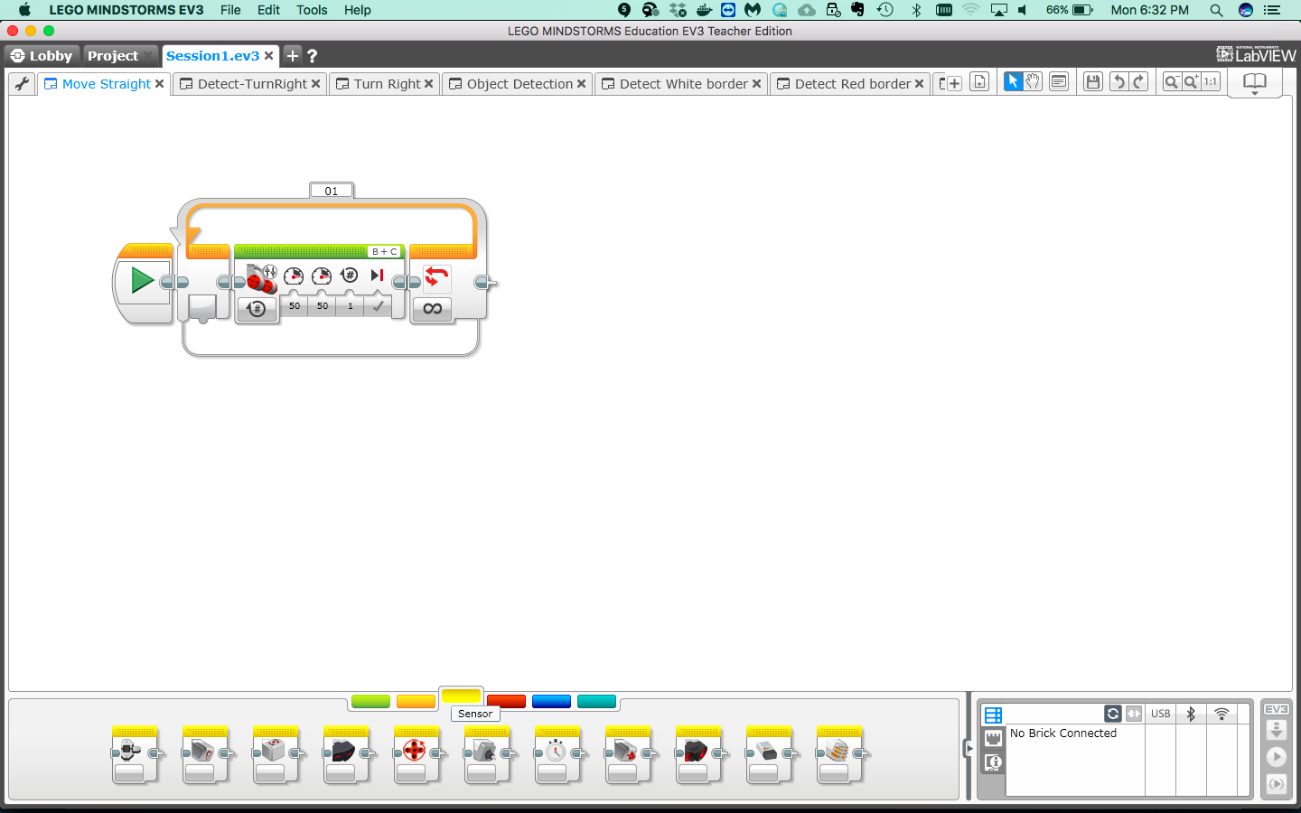
Yellow Palette = Sensor control
Yellow palette = Sensor control blocks eg. Ultrasonic sensor, color sensor, touch sensor etc.

Slide 24
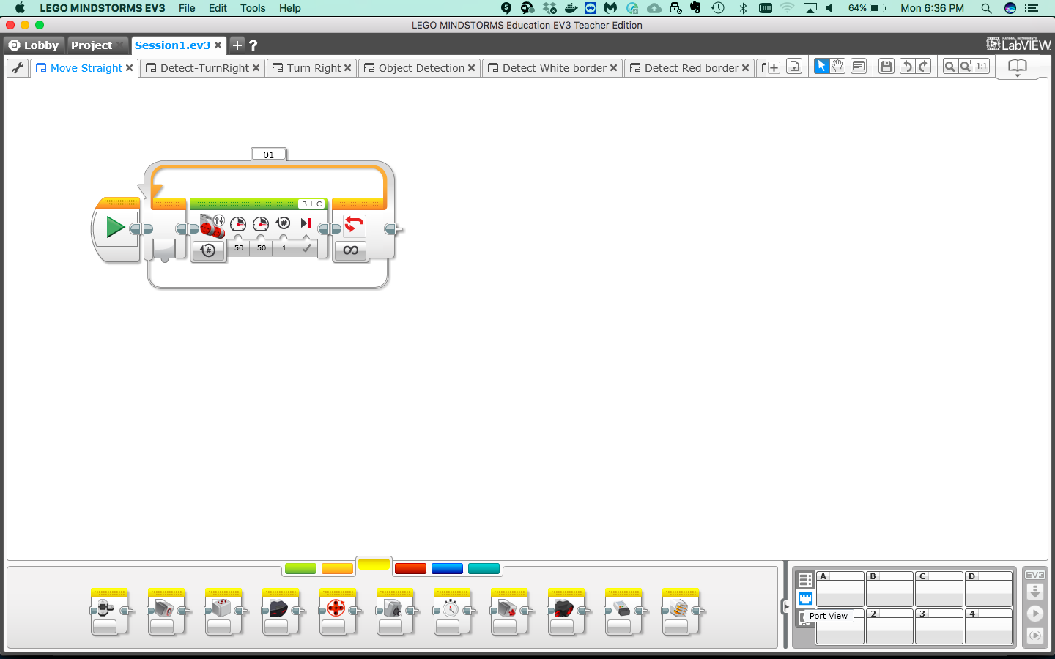
Debug Environment
Port View, note: ports are connected to one or more sensors

Slide 25
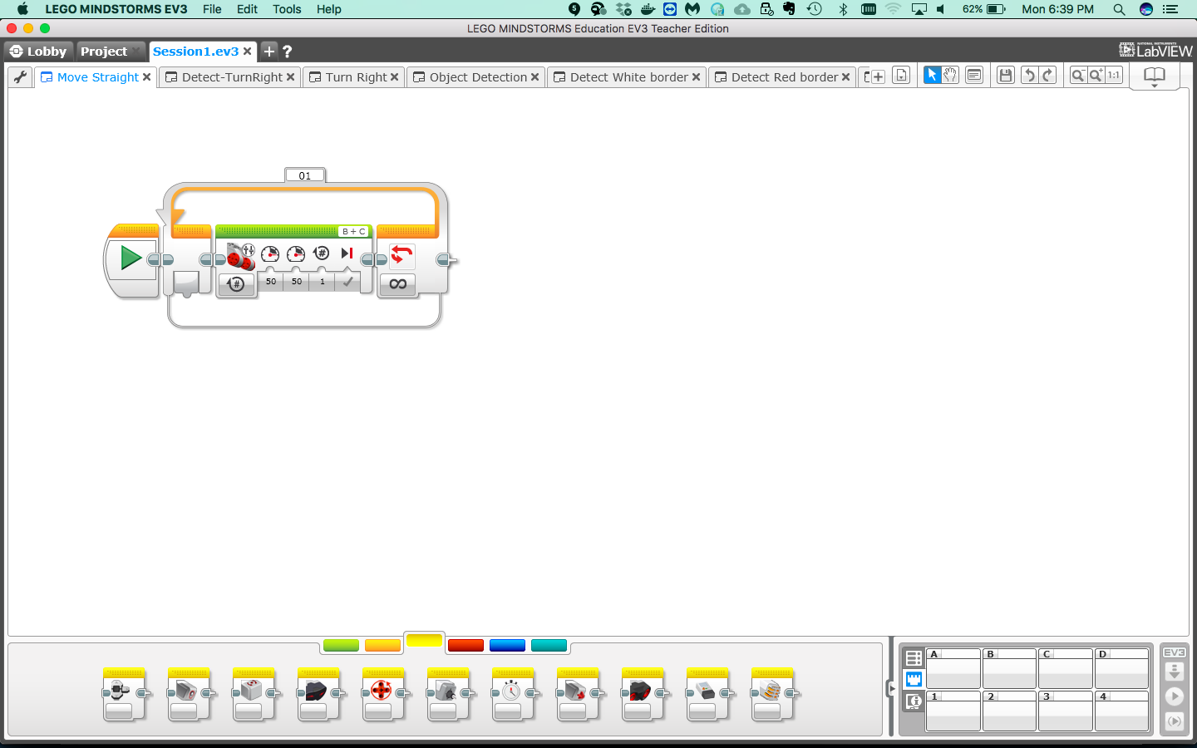
Download code
(Q) Why do we need to download code to the EV3 brick?
Download code

Slide 26
Run code
Run code

Slide 27
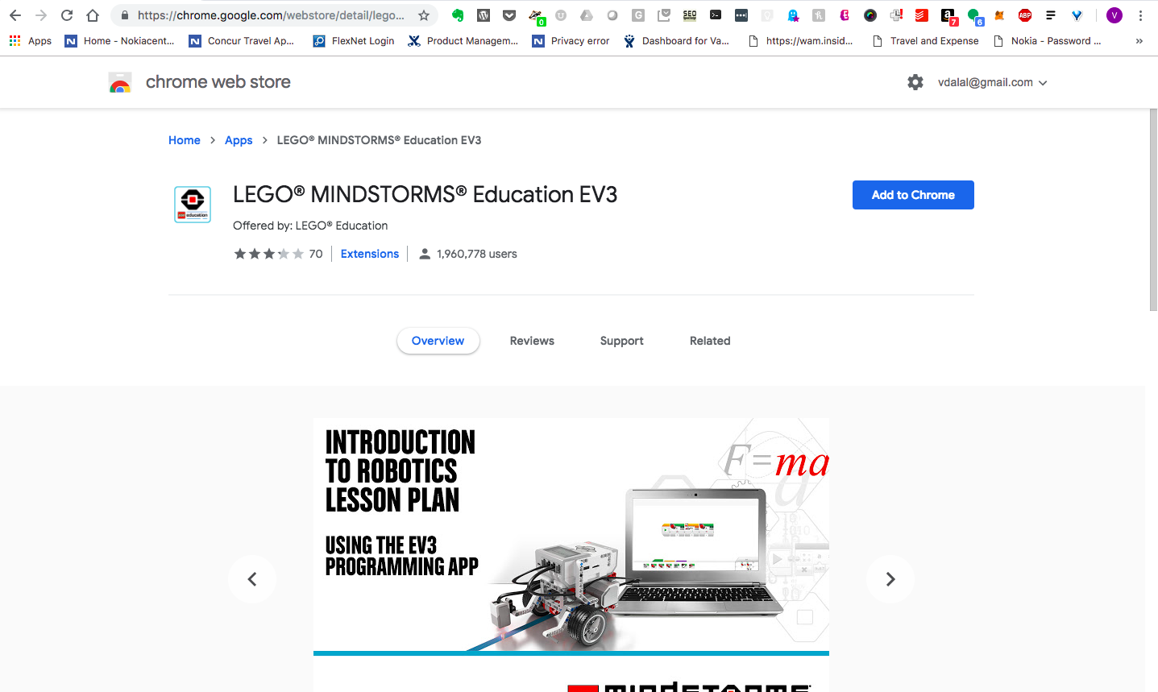
Chrome Web Store (chrome.google.com/webstore/)

Slide 28
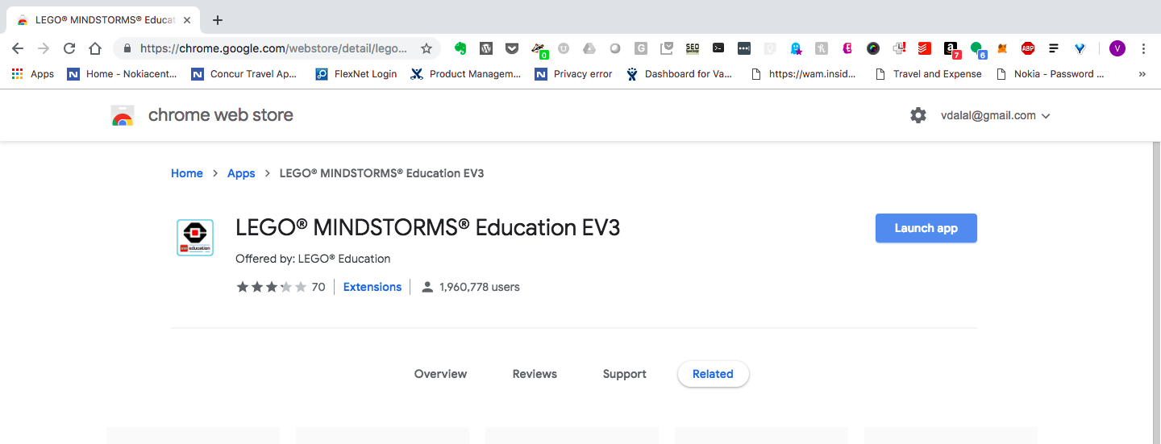
Launch App

Slide 29
FAQ
https://le-www-live-s.legocdn.com/sc/media/files/primary/engb%20campaign%20middle%20school%20ev3%20chromebooks%20faqs-80bbd7d15963de5d20a786819aa67ace.pdf?la=en-gb
https://education.lego.com/en-us/support/mindstorms-ev3/software-requirements
Chromebook
Operating system:
Chrome OS version 50 or above
Hardware:
4 GB RAM or more
1.40 GHz dual-core processor or faster
2 GB available storage space
Bluetooth 2.0 or above
Available on Chrome Web Store.
Firmware update compatibility. To confirm that your Chromebook is able to update the firmware on your EV3 Brick via USB, please open the Chrome web browser in your Chromebook and enter ‘chrome://system’ in the address bar. Locate the version number under ‘uname’. If you have version 3.14 or above, then you should be able to update your EV3 Brick via EV3 Programming. If not, please update your EV3 Brick from the EV3 Lab software.

Slide 30
Programming the Bot

Slide 31
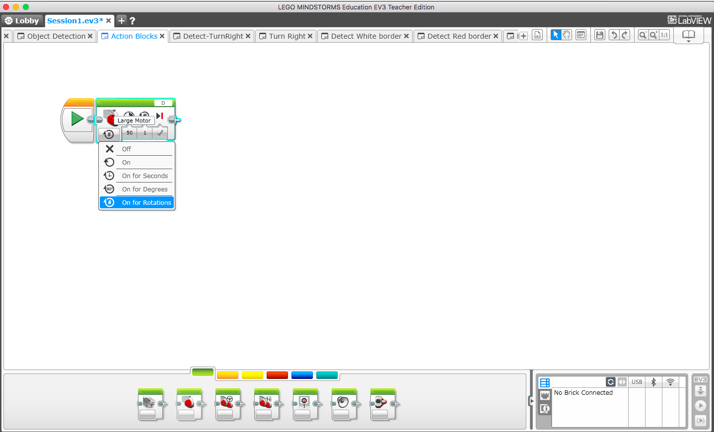
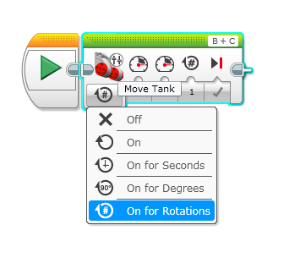
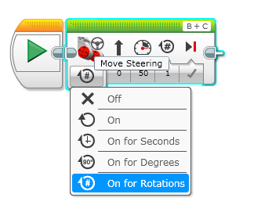
Basics: Action blocks
Large Motor
Steering
Move Tank

Slide 32
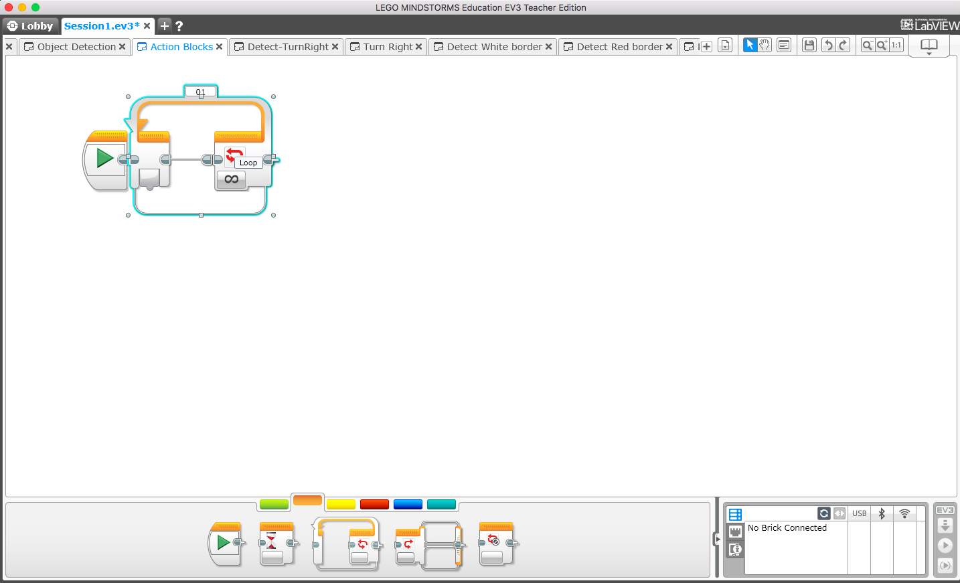
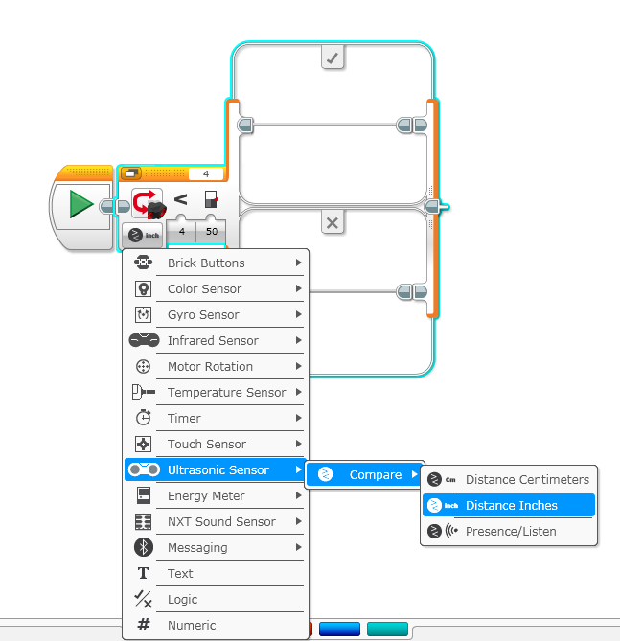
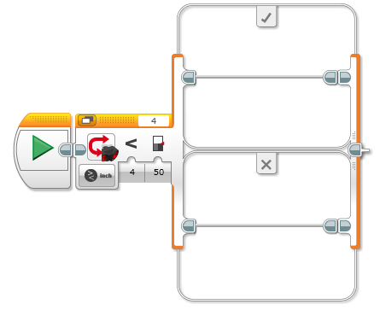
Basics: Logic/Flow Control blocks
Loop
Switch
Large Motor
Steering
condition = true
if (condition)
typically from
a sensor
condition = false

Slide 33
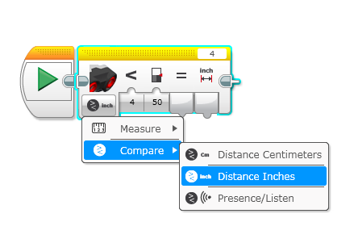
Basics: Sensor blocks
Loop
Large Motor

Slide 34
Pseudo Code
Determine what we want to accomplish in English-like language?
e.g.
Go straight forever
start
go straight (rotations = 1)
loop
Go straight forever, turn ‘right’ if object detected
start
go straight (rotations = 1)
if (object detected within 10 inches)
turn right
loop

Slide 35
Pseudo Code – (2)
Determine what we want to accomplish in English-like language
3. Go straight forever, turn ‘right’ if white line (playpen border) detected
start
go straight (rotations = 1)
if (white line detected (reflected intensity or code detection))
turn right
loop

Slide 36
Discussion Topics
Each bot acts on their own. How do the bots coordinate their actions?
How does the bot detect another bot?
What sensors shall we use?
What speed should the bot be moving at?
What should occur when your bot detects another bot?
Does can the bot avoid another bot? Does the direction of turn matter?
How does the bot stay within the playpen? How does your bot detect the red border?
What other improvements can we make? Speed? Finetune turns? etc.

Slide 37
Framework
Step 1
Step 2
Step 3
Go straight
code
Detect object/
Take Action
Detect
Playpen/ Take Action
Start

Slide 38
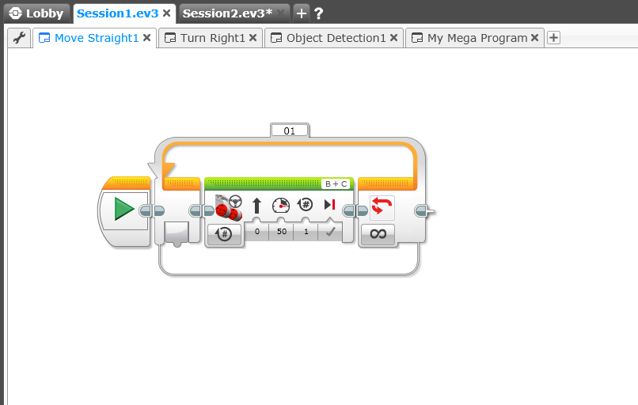
Step #1: Go Straight
Move Tank
Loop (forever)

Slide 39
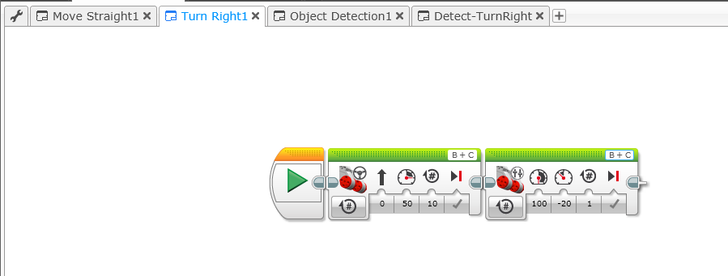
Step #2: Go Straight, Move Right
Left/Right Motor Controls
Move Tank

Slide 40
(optional) Step #2: Go Straight, Turn 180
Left/Right Motor Controls
Move Tank

Slide 41
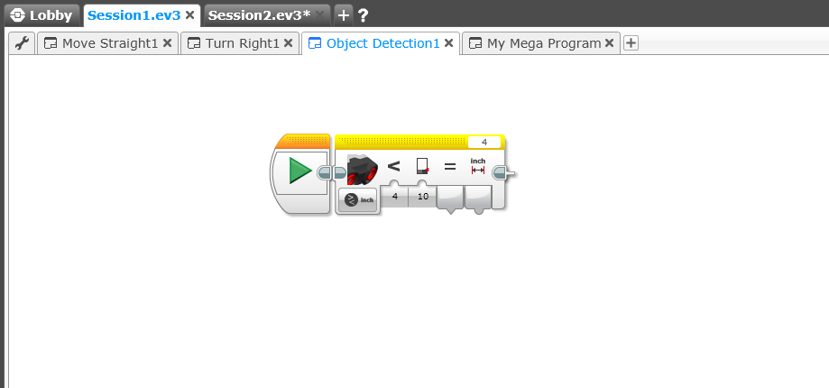
Step #3: Object Detection – (1)
Ultrasonic Sensor
Distance Detection
Controls

Slide 42
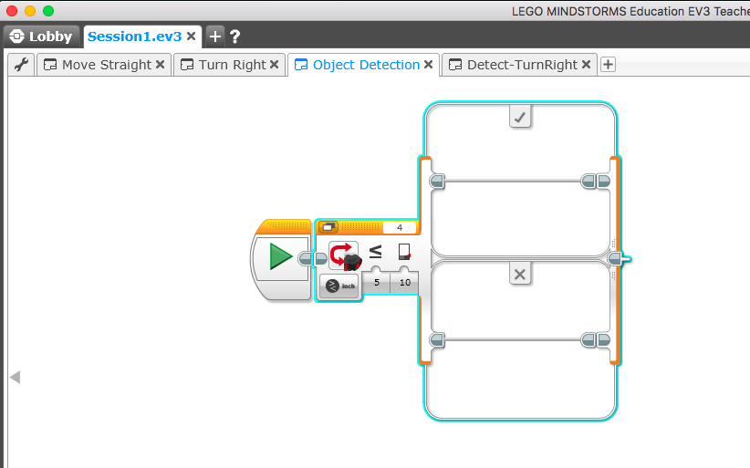
Step #3: Switch Block, Object Detection – (2)
Switch Block
If (condition = ‘Yes’)
Do this
Else
– Do that
Turn right (or 180)
Detect object
<=10 in?
Do nothing
Ultrasonic Sensor
Compare

Slide 43
Milestone #1: Detect & Turn Right (Avoid)
start
Move
straight
Detect object
<=10 in?
no
yes
Turn right (or 180)

Slide 44
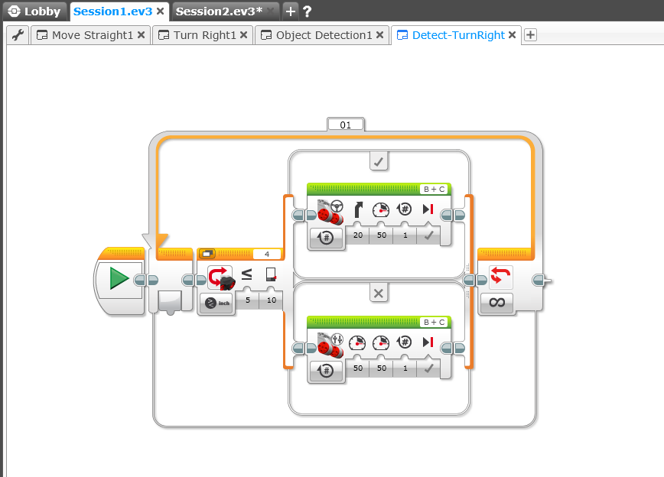
Milestone #1: Detect Object & Turn Right (Avoid) - Code
If (object within 10 inches)
- Turn right
Turn right (or 180)
Detect object
<=10 in?
Go straight
Else
- Go straight
Ultrasonic Sensor

Slide 45
Step #4: White border Detection – (1)
Light Sensor
- Reflected light intensity
Distance Detection
Controls

Slide 46
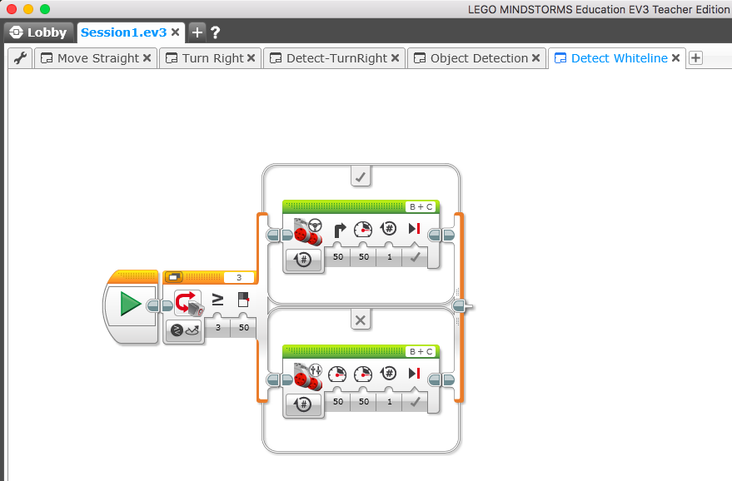
Step #4: White border Detection – (2)
Turn right (or 180)
If (white border = ‘yes’)
- Turn right
Reflected intensity >=60?
Go straight
Else
- Go straight
Light Sensor
- Reflected light intensity
Copyright © Vasu Dalal

Slide 47
Milestone #2: Detect & Avoid Object + Stay in Playpen
Option #1
start
Move
straight
Move
straight
Detect object
<=10 in?
Detect white border
?
no
no
yes
yes
Turn right (or 180)
Turn right (or 180)

Slide 48
Milestone #2: Detect & Avoid Object + Stay in Playpen
Option #2
start
no
Move
straight
Detect white border
?
yes
Detect object
<=10 in?
no
yes
Turn right (or 180)

Slide 49
Milestone #2: Detect & Avoid Object + Stay in Playpen
Option #3
start
Move
straight
Detect object
<=10 in?
no
no
Detect white border
?
yes
yes
Turn right (or 180)

Slide 50
Milestone #2: Detect & Avoid Object + Stay in Playpen
Option #4
start
Move
straight
Detect object
<=10 in?
Detect white border
?
no
no
yes
yes
Turn right (or 180)
Turn right (or 180)

Slide 51
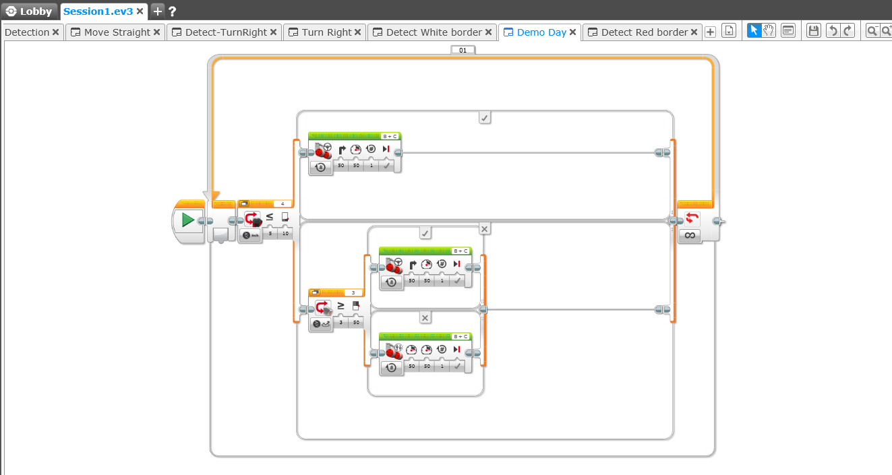
Demo Day Program
Turn right (or 180)
Detect object
<=10 in?
Turn right (or 180)
Reflected intensity >=60?
Object Sensor
Go straight
Else
- Go straight
If (whiteborder = ‘yes’)
- Turn right

Slide 52
Goal: Demo Day
Goals
Avoid crashes
Stay in the playpen
Move continuously
Thank you!
https://github.com/vdalal/lego-ev3

